Slide 1
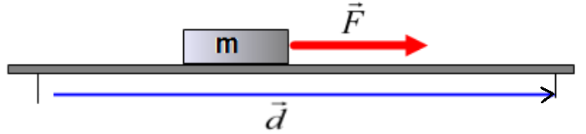

Work and Kinetic Energy Concept Questions
1. A block of mass m is pulled over a distance d by an applied force F which is directed parallel to the displacement. How much work is done on the block by the force F?
A. mFd
B. zero
C. Fd
D. F/d
E. –Fd

Slide 2
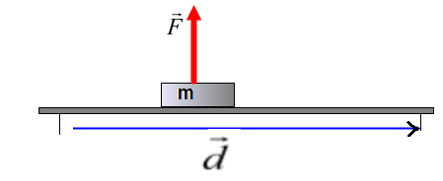
2. A block of mass m is pulled over a distance d by an applied force F which is directed perpendicular to the displacement. How much work is done on the block by the force F?
A. mFd
B. zero
C. Fd
D. F/d
E. –Fd

Slide 3
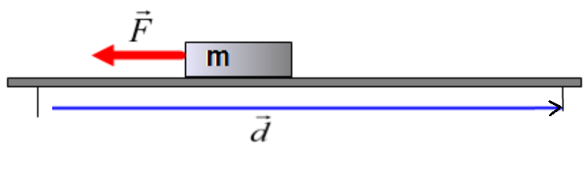
3. A block of mass m is pulled over a distance d by an applied force F which is directed opposite to the displacement. How much work is done on the block by the force F?
A. mFd
B. zero
C. Fd
D. F/d
E. –Fd

Slide 4
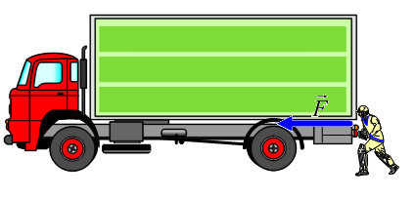
4. A truck driver is trying to push a loaded truck with an applied force. Unfortunately, his attempt was unsuccessful the truck stays stationary no matter how hard the driver pushes. How much work is done by the driver?
A. Fd B. –Fd C.F/d D. d/F E. Zero

Slide 5
5. A spacecraft moves around Earth in a circular orbit with a constant radius. How much work is done by the gravitational force on the spacecraft during one revolution?
A. F_{G}d B. - F_{G}d C. mgh D. ½ mv² E. zero

Slide 6
6. An object is thrown straight up. Which of the following is true about the sign of work done by the gravitational force while the object moves up and then down?
A. Work is positive on the way up, work is positive on the way down
B. Work is negative on the way up, work is negative on the way down
C. Work is negative on the way up, work is positive on the way down
D. Work is positive on the way up, work is negative on the way down
E. Work is zero the way up, work is zero on the way down

Slide 7
7. An object with mass 300.0 g is moving at 5.0 m/s. What is its kinetic energy?
A. 750 J
B. 3750 J
C. 3.75 J
D. 0.75 J
E. 6.0 J

Slide 8
8. An object has a speed of 1.0 m/s a kinetic energy of 5.0 J. What is the new kinetic energy if the speed is doubled?
A. 10.0 J
B. 20.0 J
C. 2.5 J
D. 1.25 J
E. You can’t find the new kinetic energy without knowing the
mass.

Slide 9
9. What happens to the kinetic energy of a moving object if the net work done is positive?
A. The kinetic energy increases
B. The kinetic energy decreases
C. The kinetic energy remains the same
D. The kinetic energy is zero
E. The kinetic energy becomes negative

Slide 10
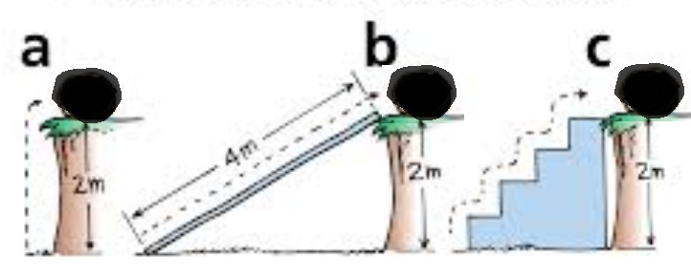
10. A rock is raised up to the top of a cliff three different ways. In which case is the potential energy the greatest?
a b) b c) c d) The potential energy is the same at all points.

Slide 11
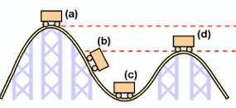
11. At what point in the roller coaster’s path is the speed the greatest?
a) b) c) d)

